Slide 1
Department of mathematics
SGGSJ GOVERNMENT COLLEGE
PAONTA SAHIB

Slide 2
COURSE NAME : DIFFERENTIAL EQUATIONS
COURSE CODE : 102TH

Slide 3
CONTENTS
Wronskian – Definition
Some important definitions
Properties of Wronskian
Some examples of Wronskian

Slide 4
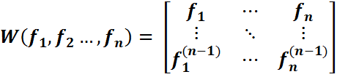
WRONSKIAN AND ITS PROPERTIES
DEFINITION:
Wronskian of n real function f₁, f₂, … f_{n} having derivatives upto (n – 1) order over an open interval denoted by W(f₁, f₂, … f_{n}), is defined as the determinants.

Slide 5
LINEAR COMBINATIONS:
A function f is called a linear combination of function f₁, f₂, … f_{n} if f can be expressed as
f = C₁f₁ + C₂f₂ +…+ C_{n}f_{n} , for same constant C₁ , C₂ , …., C_{n}
LINEARLY DEPENDENT FUNCTION :
The functions f₁, f₂, … f_{n} of x are said to linearly dependent over an interval I iff there exists constants C₁ , C₂ , …., C_{n} (not all zero) such that
C₁f₁ + C₂f₂ +…+ C_{n}f_{n} = 0 , ∀ x∈I
LINEARLY INDEPENDENT FUNCTION :
The functions f₁, f₂, … f_{n} of x are said to linearly dependent over an open interval I iff there exists constants C₁ , C₂ , …., C_{n} such that
C₁f₁ + C₂f₂ +…+ C_{n}f_{n} = 0 , ∀ x∈I

Slide 6
PROPERTIES OF WRONSKIAN
PROPERTRY 1. If the Wronskian of the function f₁ , f₂ …, f_{n} , over an interval l is non zero then these functions are linearly independent over I .
PROPERTY 2. If f₁ , f₂ …, f_{n} are linearly dependent functions over I then,
W(f₁ , f₂ …, f_{n} ) =0 ∀ x∈I

Slide 7
PROBLEMS BASED ON WRONSKIAN
PROBLEM 1:
Show by wronskian that x, x³, x⁴ are linearly independent if x is non-zero .
SOLUTION:
Let f₁(x) = x , f₂(x) = x³ , f₃(x) = x⁴
f′₁(x) = 1 , f′₂(x) = 2x³ , f′₃(x) = 4x³
f″₁(x) = 0 , f″₂(x) = 6x² , f″₃(x) = 12x² .
Then,

Slide 8
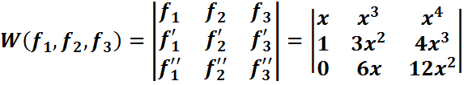


= by R₂→R₂ -R₁
=
= 6x⁵ ≠ 0 as x ≠ 0
W(f₁ , f₂ , f₃ ) ≠ 0
f₁ , f₂ , f₃ are linearly dependent.

Slide 9
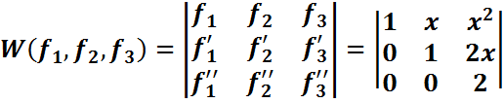
PROBLEM 2.
Show by Wronskian that the following functions are linearly independent :
1 ,x ,x² , (ii) e^{x} ,e^{2x} ,e^{3x} .
SOLUTION: (i)
Let f₁(x) = 1 , f₂(x) = x , f₃(x) = x²
f′₁(x) = 0 , f′₂(x) = 1 , f′₃(x) = 2x
f″₁(x) = 0 , f″₂(x) = 0 , f″₃(x) = 2
∴

Slide 10
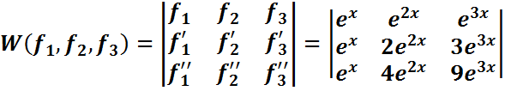
= (1)(1)(2) [product of diagonal elements]
= 2 ≠0 ∀ x∈R
∴ W(f₁ , f₂ , f₃ ) ≠ 0
f₁ , f₂ , f₃ are L.I over all reals.
(ii) Here,
f₁(x) = e^{x} , f₂(x) = e^{2x} , f₃(x) = e^{3x}
f′₁(x) = e^{x} , f′₂(x) = 2e^{2x} , f′₃(x) = 3e^{3x}
f″₁(x) = e^{x} , f″₂(x) = 4e^{2x} , f″₃(x) = 9e^{3x}
Then,

Slide 11

= e^{6x} (8–6)
= 2 e^{6x} ≠0 ∀ x∈R
∴ W(f₁ , f₂ , f₃ ) ≠ 0
f₁ , f₂ , f₃ are L.I over all reals.

Slide 12
THANK YOU

